Slide 1

Secure banking application in cloud Using DNA Cryptography
Batch N0: A-05 Project Guide:
D.Lakshmi (164G1A0544) Mrs.M.Soumya, M.Tech.
M.Archana (164G1A0507) Assistant Professor.
M.Mani Chaitanya (164G1A0552)
V.Divya (164G1A0524)
Srinivasa Ramanujan Institute of Technology
Department of Computer Science & Engineering

Slide 2
Abstract:
Cloud computing denotes an IT infrastructure where data and software are stored and processed remotely in a data center of a cloud provider, which are accessible via an Internet service.
DNA cryptography is a relatively new paradigm that has attracted great interest in the field of information security.
Session management in distributed Internet services is traditionally based on username and password, Emerging biometric solutions allows a single verification.
A secure protocol is defined for perpetual authentication through continuous user verification.

Slide 3
Flowchart
Login
User
Server
Registration
Customer Details
Account Details
Activate Beneficial
Transaction
Transaction
Verification
Activate Blocked Account
Add Beneficial
Money Transfer

Slide 4
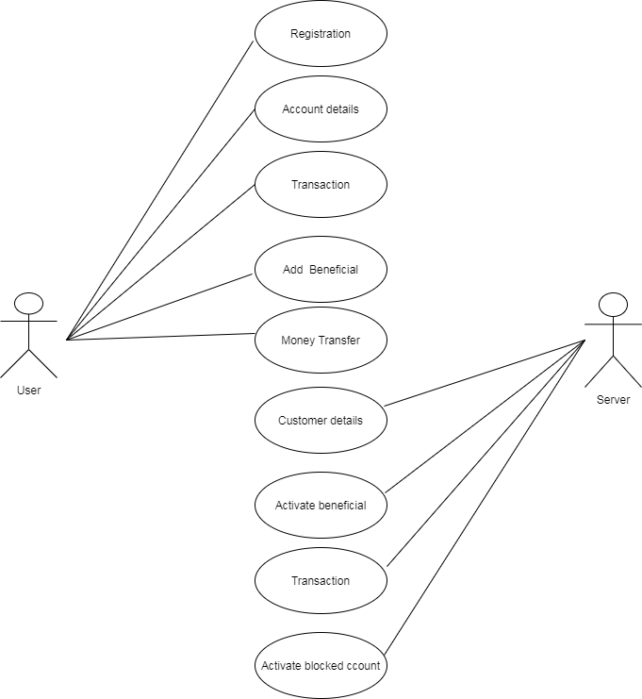
Design(Use case):

Slide 5
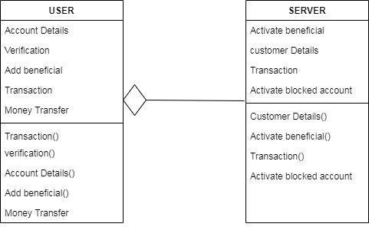
Class diagram:

Slide 6
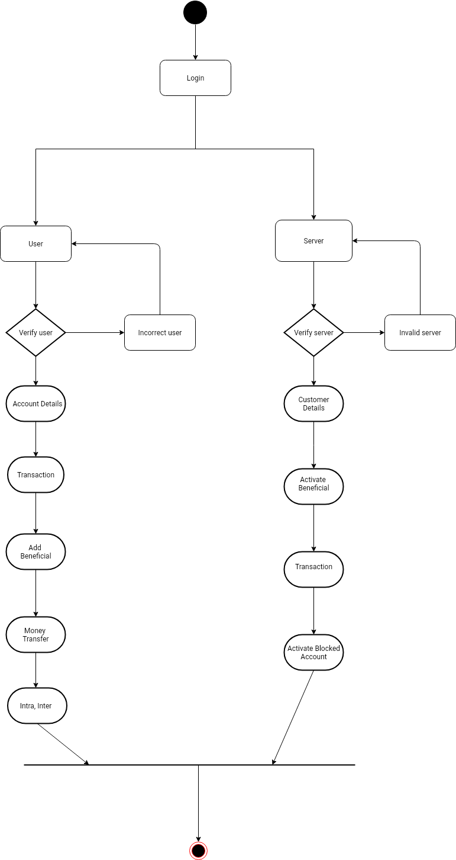
Activity diagram:

Slide 7
Implementation
System Model
DNA Verification
Continuous Authentication
Authentication Server

Slide 8
System Model
"User Id" refers to the identity of the user obtained from the Bank for the purpose of logging into the Internet Banking facility provided by the Bank.
"Login Password" is a unique and randomly generated password known only to the customer, which can be changed by the user to his/her convenience. This is a means of authenticating the user ID for logging into Internet Banking.

Slide 9
Continued….
"Transaction Password" is a unique and randomly generated password known only to the customer, which can be changed to his/her convenience. This is a means of authentication required to be provided by the customer for putting through the transaction in his/her/their/its accounts with Bank through Internet Banking. While User ID and Password are for valid access into the internet application, giving valid Transaction Password is for authentication of transaction/requests made through internet.

Slide 10
DNA verification
In this module ,we verify the finger print of the person and if the fingerprint match it opens the user module and if the finger print doesnot match then it displays fingerprint doesnot match.

Slide 11
Continuous Authentication
A secure protocol is defined for authentication through continuous user verification. The protocol determines adaptive timeouts based on the quality, frequency and type of biometric data transparently acquired from the user.

Slide 12
Continued….
The idea behind the execution of the protocol is that the client continuously and transparently acquires and transmits evidence of the user identity to maintain access to a web service. The main task of the proposed protocol is to create and then maintain the user session adjusting the session timeout on the basis of the confidence that the identity of the user in the system is genuine.

Slide 13
Authentication Server
The Server maintains the functionality:
Customer Details
Activation of Beneficiary
Transaction Details
Activate Blocked Account

Slide 14
THANK YOU
Queries
?

